Slide 1
PANORAMA and Fluorescence images of H460/NHBE exosome mixture and Plasma
By Nareg Ohannesian
05-13-2021

Slide 2
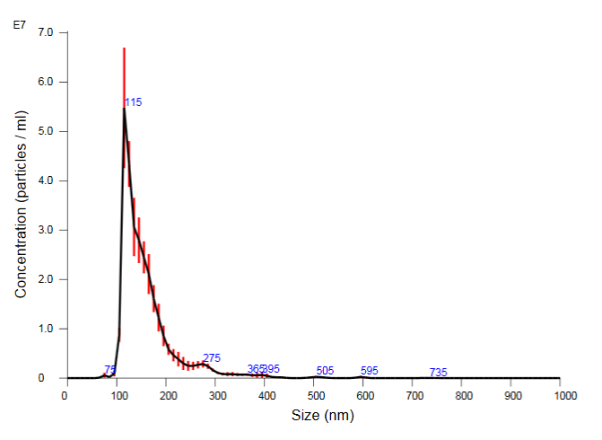
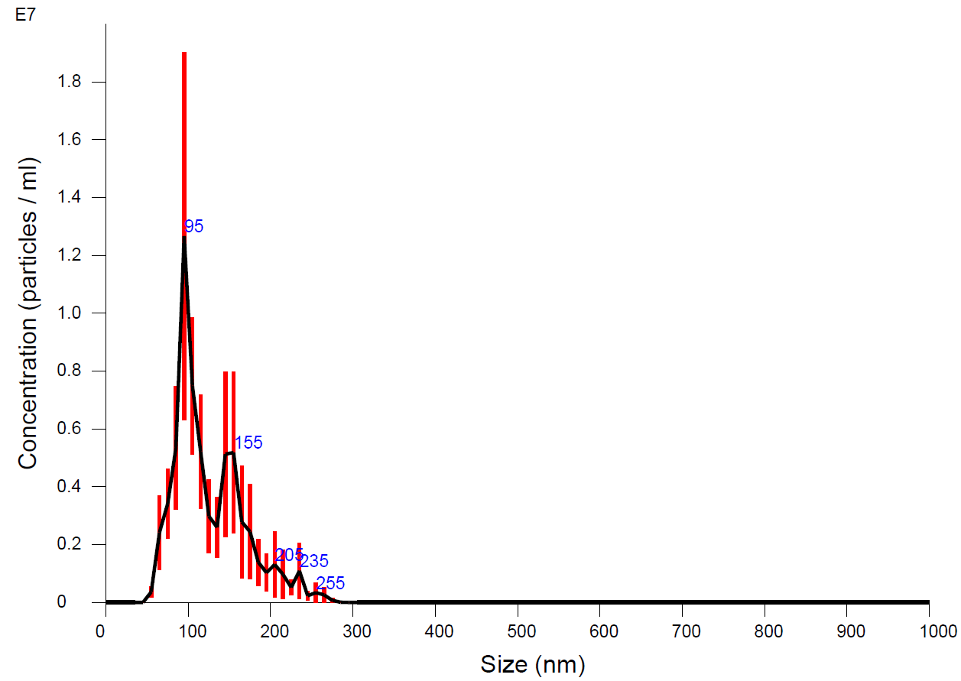
Experimental Details
Cy3 labelled molecular beacon: 50 µl of 6x10^14 molecule/µl
Excitation: 520-555 nm (max 545 nm)
Emission: 565-600 nm (max 570 nm)
Acquisition time: 0.5 sec
Target molecule: miRNA-21
MB sequence: /5Cy3/GCGCGTCAACATCAGTCTGATAAGCTACGCGC/3BH
Exosome used: H460; NHBE
Antibody for capture: CD9; CD63; CD81
Concentrations used: 2x10⁴ ex/ µl.
Volume used: 20 µl
Experiment duration: 45 min
Fluorescence filters used:
Excitation wavelength: 512-550 nm
Emission wavelength: 570-615 nm
Dichroic Mirror: 560 nm
NHBE SIZE DISTRIBUTION
H460 SIZE DISTRIBUTION

Slide 3
Fluorescence Response of cancerous and non-cancerous exosomes to miR-21 biomarker via molecular beacon
Exosomes Cell Line | H460 | 293A | MCF10A | NHBE
Fluorescence Particle Intensity | 436±228 509±358 | 308±63 | 389±118 | 0
Fluorescence Background Intensity | 45±42 40±41 | 36±25 16±47 | 19±40 | 24±40 20±32
% of mir21 response (fluor count/pan count) | 70-90% (715/944) | 13.5-15 % (123/906);(165/1043) | 7-10 % (93/1297) | 0 % (0/928)
Cell Type | Cancer Immortalized Lung | Non-cancer Immortalized embryonal kidney | Non-cancer Mammary epithelial cell | Non-cancer Bronchial epithelial cell
PANORAMA IR | 1.115±0.046 1.125±0.048 | 1.13±0.055 1.12±0.05 | 1.108±0.046 | 1.10±0.051 1.13±0.04

Slide 4
Summary of NHBE and H460 exosomes mixture on miR-21 biomarker
NHBE-H460 Mixture % of H460 (% of NHBE) | 0% (100) | 15% (85) | 25% (75) | 50% (50) | 100% (0)
Fluorescence Particle Intensity | 0 | 620 ± 210 | 401 ± 199 | 442 ± 199 | 436 ±228 509 ± 358
Fluorescence Background Intensity | 24±40 20±32 | 6±17 | 38 ± 29 | 7 ± 13 | 45±42 40±41
% of miR-21 response Within the population | 0 % (0/928) | 12-13 % (113/927) (12%/15%= 80%) | 20 % (296/1430) (20%/25%=80%) | 34-38 % (275/782) (36%/50%=72%) | 70-90 % (715/944)
PANORAMA IR | 1.10±0.051 1.13±0.04 | 1.108 ± 0.07 | 1.117 ± 0.059 | 1.11 ± 0.051 | 1.115±0.046 1.125±0.048

